Slide 1
Design Thinking
and the 4Cs

Slide 2
The 4Cs
Collaboration
Communication
Critical Thinking
Creativity
Notes:
I want to start with a bit of background knowledge for those not familiar with the 4cs
Explain the 4Cs

Slide 3
21st Century Skills
Notes:
Together they form the 21st Century Skills
Now how did they come about,
Ten years ago, National Education Association or NEA helped establish the Partnership for 21st Century Skills (P21) and in 2002 began a two-year journey to develop what became known as a “Framework for 21st Century Learning,” highlighting 18 different skills that students needed.
Over the years it became clear that the framework was too long and complicated. To resolve this issue, we interviewed leaders of all kinds to determine which of the 21st century skills were the most important for K-12 education. There was near unanimity that four specific skills were the most important. They became known as the “Four Cs”

Slide 4
Design Thinking
In Education
Human-Centered
Collaborative
Inclusive
Transforming
Difficult Challenges
Opportunities
Design
Social Change
Notes:
So now that we have established some baseline I want to talk about DT
Design thinking is a human-centered, collaborative, and inclusive process for transforming difficult challenges into opportunities for design.
In education design thinking is human-centered, collaborative, and inclusive process for transforming difficult challenges into opportunities for social change

Slide 5
DT Phases
Discovery
Interpretation
Ideation
Experimentation
Evolution

Slide 6
Discovery=Collaboration
Define the challenge
Parents’ lack of access to and knowledge of technology (Do parents see technology in education differently based on their socio economic status? If so, what can we do to bridge that gap (or meet the needs of all parents?)?)
Notes:
First we needed to define our challenge, in this case we wanted to answer the following question,
Those (read screen)
Our end User were parents

Slide 7
Discovery=Collaboration
How can we empower parents and other community members to practice digital citizenship and literacy skills when using technology and guiding their children in using technology?
Notes:
We wanted to gather data on this question because we felt it was important to reach parents and the use of technology in their children
In order to understand our end user we needed to reach them not just assume we knew what they wanted
Talk about assumptions (lack of access)

Slide 8
Discovery=Collaboration
Parent survey
Student survey
Interviewed an expert
Notes:
so we designed a survey and gave out to parents
Then we waited and what we received back was different than our assumptions

Slide 9
Interpretation=Critical Thinking
100% of Parents Self Selected as families having access at home
100% Believed digital safety was important as personal safety
100% of parents said their child had not been cyberbullied
Notes:
This is what we saw primarily and our focused changed

Slide 10
Interpretation=Critical Thinking
How do we best educate parents at elementary and middle school levels in internet safety and digital citizenship?
Notes:
We went from thinking about access such as the digital divide to to the digital gap

Slide 11
Ideation=Communication
The crazy and wild ideas phase
Notes:
So we took that information and used to it come up with ideas out in categories to try to see what did we want to do

Slide 12
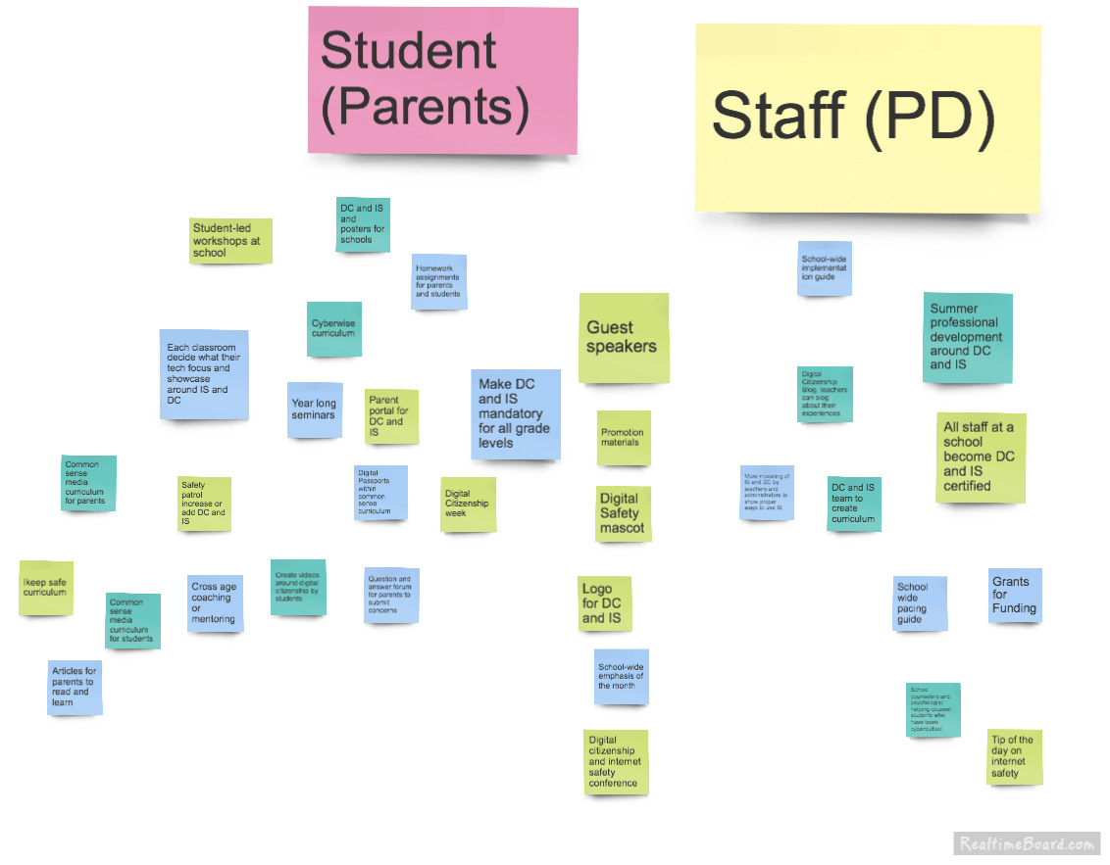
Ideation=Communication
Notes:
You may not be able to read it but one idea was to create a mascot
A national campaign and a fair
Based on this information we

Slide 13
Experimentation=Creativity
3 Ideas
A booth for a fair
Digital curriculum for parents and students
A Parent Conference
Notes:
We came up with 3 ideas

Slide 14
Experimentation=Creativity
We created prototypes
Notes:
We created prototypes and released out to the world for feedback

Slide 15
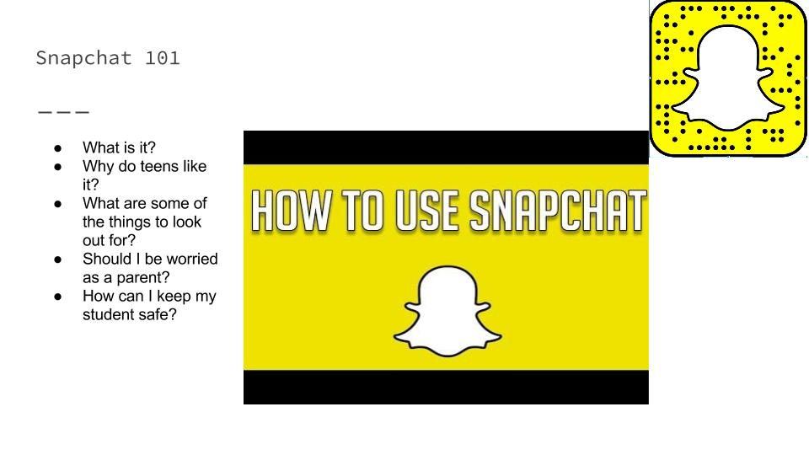
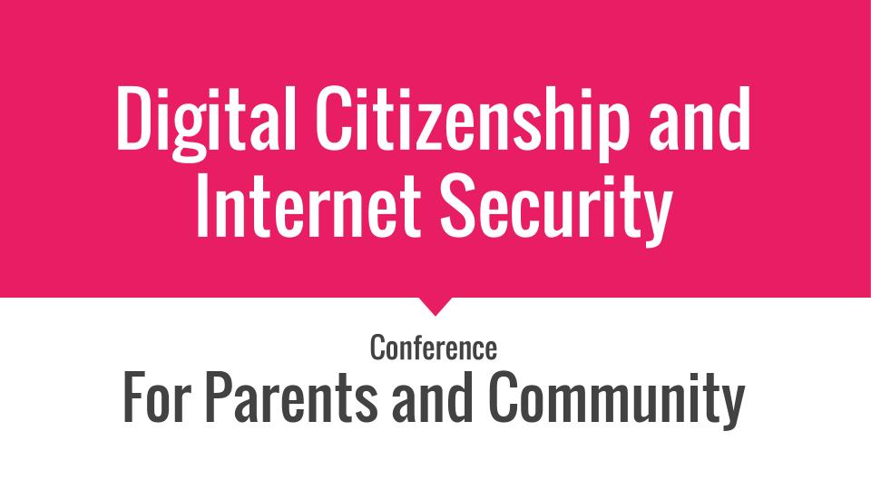
Experimentation=Creativity
Notes:
We created prototypes and released out to the world for feedback

Slide 16
Evolution=21st Century Skills
3 Ideas
A website for parents
Digital curriculum for parents and students
A Parent Conference
Notes:
In this final phase this evolved to these three ideas

Slide 17
So what?
Notes:
What is the message of design thinking

